Slide 1

Experiments for Understanding
Session 3

Slide 2
Designs for Understanding
The Experimental Approach
The Observational Approach
Notes:
We used both of these earlier to great effect in the water leak idea

Slide 3

Single-Factor Designs

Slide 4
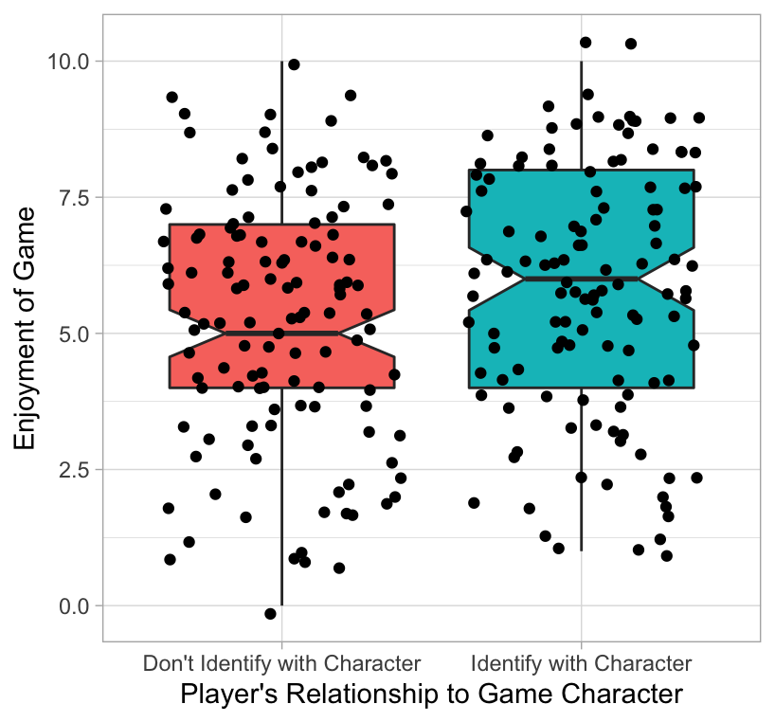
Experimental
“A/B” Test
Randomly assign people to two (or more) groups
Compare means (or other stat) on outcome
What’s the story here?
Notes:
Researcher assigns people to play a character that they either identify with in a salient (gender, physical appearance, etc.) way or to play a character that they do not identify with.
CAUSES more enjoyment
If this had been observed (earlier), no way to know whether people who DO identify with their characters differ in other ways. And they probably do

Slide 5
The Experiment: Between Subjects
Don’t Identify with Character
Researcher manipulates variable (rules out reverse causation)
Random assignment rules out confounds
Clear interpretation—causation (unless you add a confound!)
Identify with Character
Group 1
Group 2

Slide 6

A/B Tests—Caution
Time / money / effort intensive
Contextual (less external validity)
To design choices
To population
Effect established, but could still go both ways (need series of experiments)
Notes:
Contextual. Had to make a lot of decisions to set the conditions. Who is to say that those wouldn’t change the outcome?

Slide 7
Discuss
Select one element from your theory of what makes a game “fun”
Design a two-group experiment to test one element of it (experimental group, control group)

Slide 8

Python Exercise

Slide 9
Factorial Designs

Slide 10
Factorial Design
Manipulate many things at once (“Multivariate”)
Can assess independent + joint impact of each
Other factors (e.g., other causes of enjoyment)
Contextual factors (e.g., different contexts)
Audience factors (e.g., gender)
Unlimited number—but caution!
 | Identify w/ Character | Don’t identify w/ Character
Action-Driven Level
Story-Driven Level
Notes:
With role-playing element

Slide 11
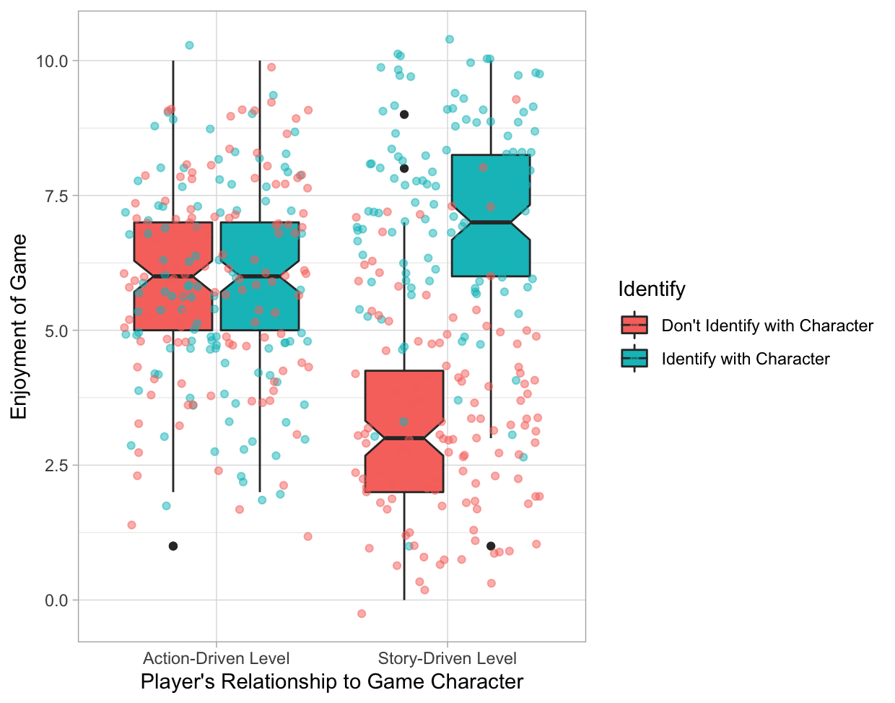
Factorial Design
Main effects vs. Interactions
Notes:
Unpack story of graph. Note that the aggregation in the regular A/B test was masking a huge finding!
In observational research, you just have to measure those variables; in experimental research you MUST actively manipulate them or its game over

Slide 12
Discuss
Take your two-group experiment and add another factor
Context factor? Audience factor?

Slide 13
Python Exercise

Slide 14
Caution! Multiple Testing
More groups per variable = more possible comparisons
More factors manipulated = many possible interactions
False positives increase exponentially

Slide 15
Caution! Multiple Testing
More groups per variable = more possible comparisons
More factors manipulated = many possible interactions
False positives increase exponentially

Slide 16
Bonferroni Correction
Declare effect “significant” if p < (.05 / # of tests)

Slide 17
Python Exercise

